Slide 1

Mock Plus Prototype
Guided By: Dr. Dhananjay Kalbande Sir
Presented By: Amrita Tulshan

Slide 2
Features
Support for Windows, Mac, iOS and Android
200 Components
8 Markup Components
8 Pre-Designed Interaction Components
Auto Backup
Batch Modification
Cloud Sync (Pro)
Component Remarks
Import/Export of Component/Project Fragments
Interaction States
Masters
My Favorites
Print (Pro)
Sketch and Wireframe Style
Visualized Interaction Design
And more!

Slide 3
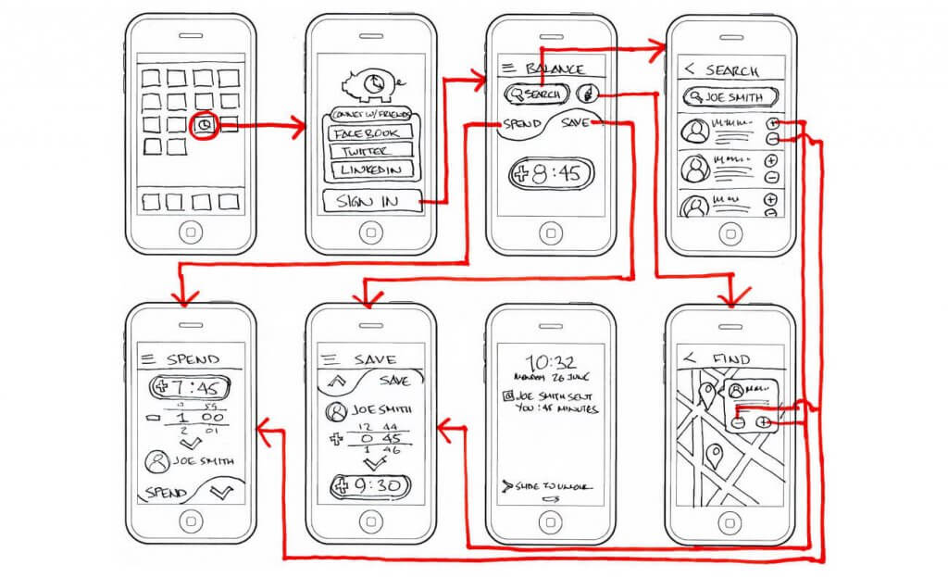
Start with Pencil and Paper

Slide 4
Basics Of Prototype
What is prototype?
Importance of prototype?
Requirements of Prototype?

Slide 5
How to use MockPlus
Design Specification:
Learning and mastering some design specifications of prototyping can help to make a more normative and beautiful prototype.

Slide 6
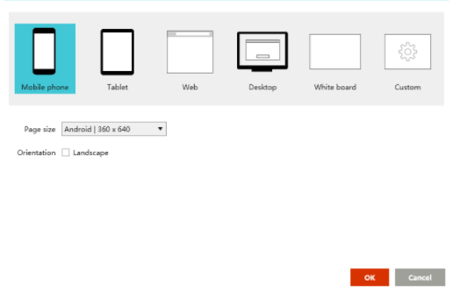
1.Project Type

Slide 7
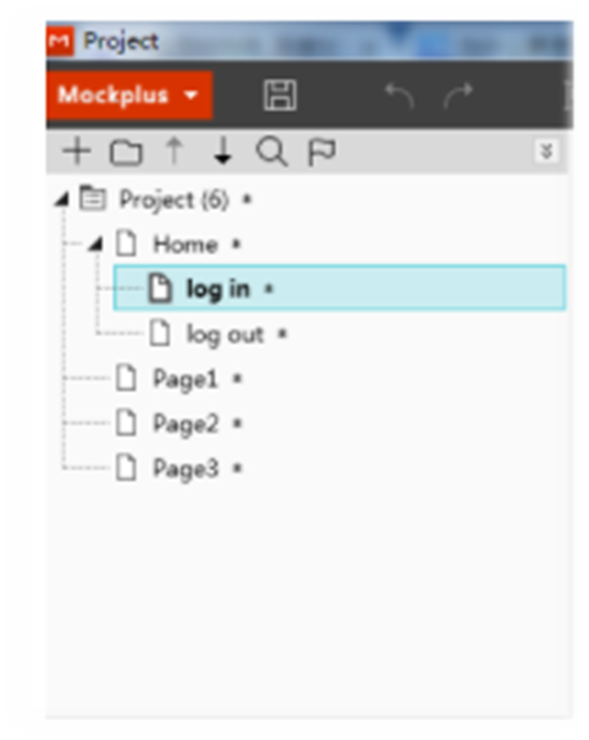
Project Tree

Slide 8
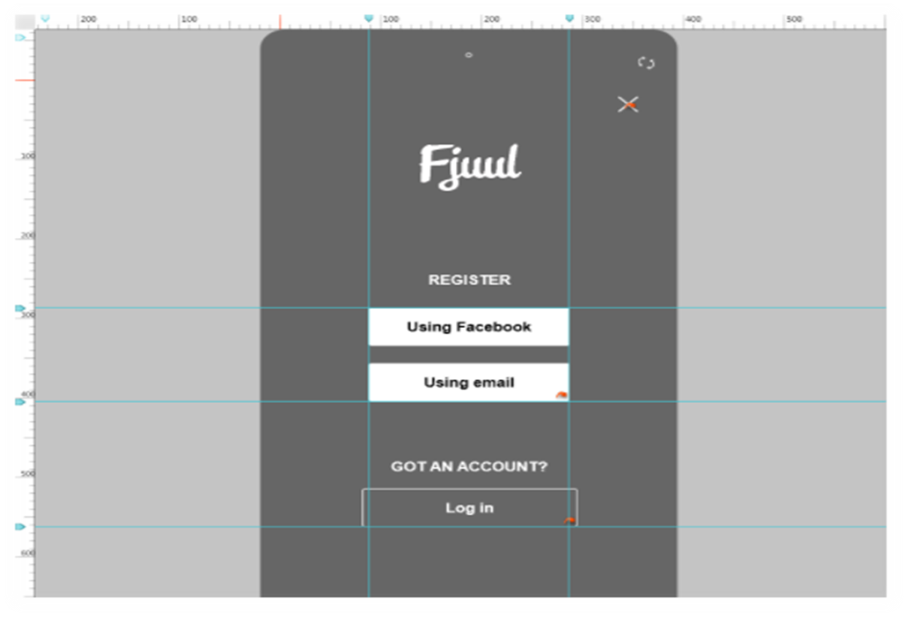
Ruler

Slide 9
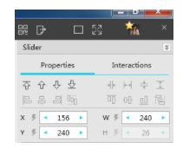
Align and Distribute
Harmonious Proportion
Clear Logic

Slide 10
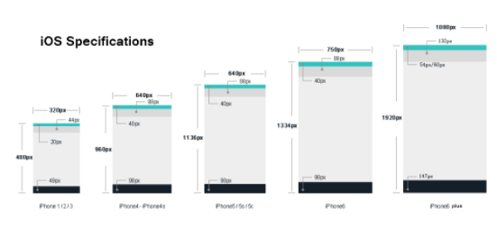
Layout Specification
Specifications of iOS:

Slide 11
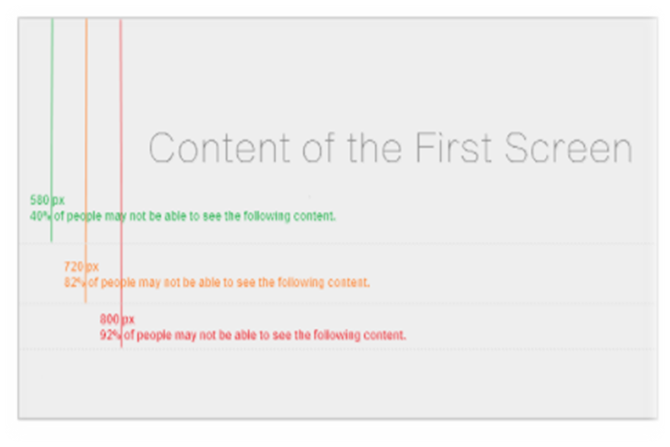
The size of the first screen of Window XP is 580px; that of window 7 is710px.
Important content should be put within lines to ensure that it is visible to most people.
Specifications of WEB::

Slide 12
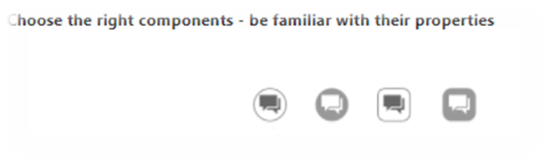
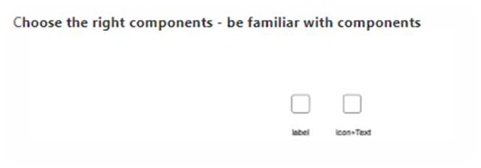

Usage of Components
The left one is a Label, and the right one is an Icon+Text. The two look the same, but the left one is an icon and can be used by simple drags and drops, saving time and increasing efficiency.
The appearance of a component is relatively fixed, but by changing its properties, various effects can be obtained. As is shown in the above picture, double click to add an icon on the button, and then we get the first component; change its color to make it solid, and then we get the second component; change its shape to make it a curved rectangle, and then we get the third component; change its color to make it a solid curved rectangle, and we get the fourth component.

Slide 13
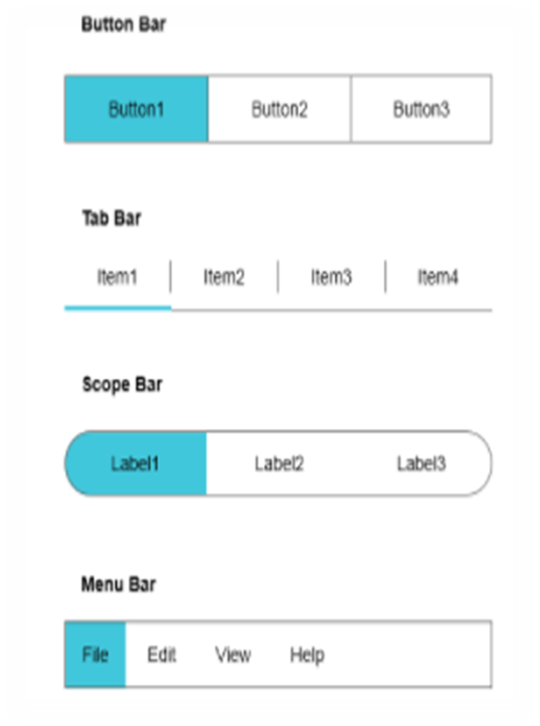
Similarly, the above-left one is a Button which is equivalent to a Shape+Icon+Text on the right.

Slide 14
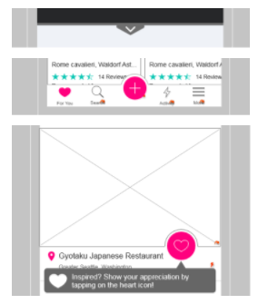
Combined Components
All of the three examples are made by combined components. The first one is made by a Shape and a sharp-angled arrow; the second one is curved navigation bar, made by a Shape, a Circle with border, and a Shape without border to cover the lower half; the third one is made by an Image, a Circle with border, and a Shape without border to cover the lower half.
The combined components made by yourself can be saved to the Template and My Libraries, for you can use them directly next time.

Slide 15
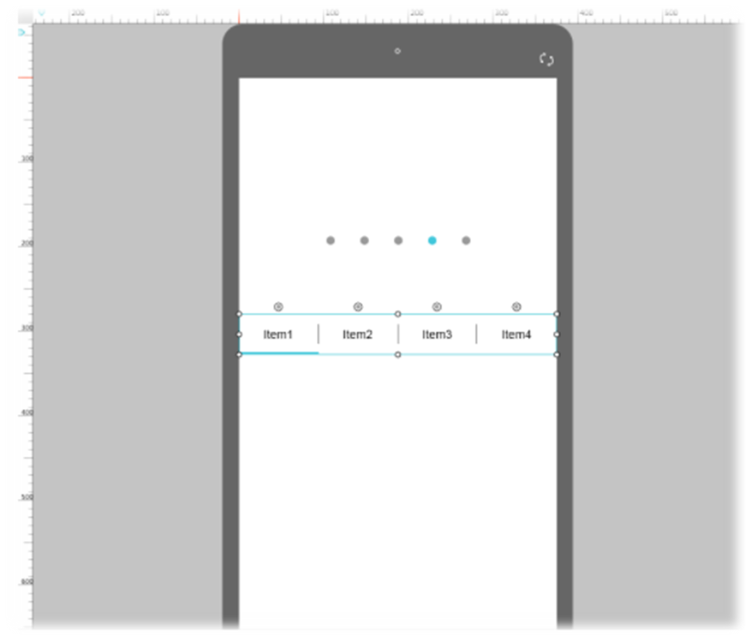
Example
How to use a Tab Bar to make a Page Control
Actually, Page Control is already-made in Mockplus, but now we take Using a Tab Bar to make a Page Control as an example, to teach you how to make a desired component by changing its properties.
Drag a Tab Bar and a Page Control to the canvas; observe carefully the style of the Page Control and then change the properties of the Tab Bar based on it.

Slide 16
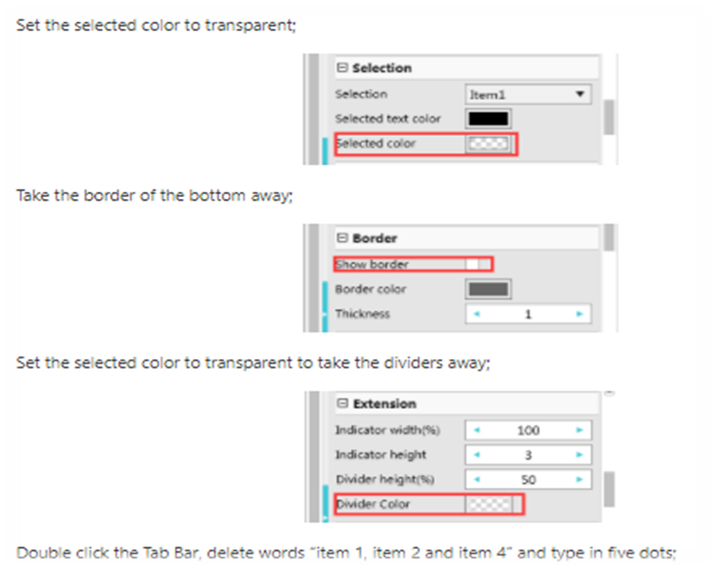

Slide 17
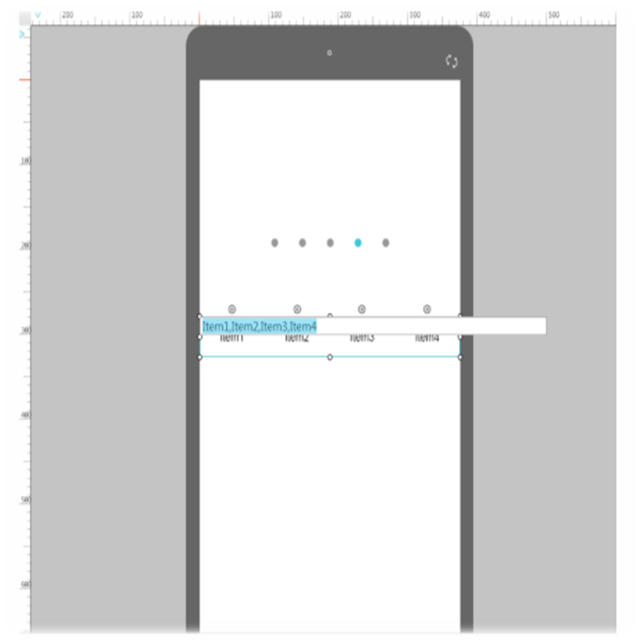
Double click the Tab Bar, delete words “item 1, item 2 and item 4” and type in five dots;

Slide 18
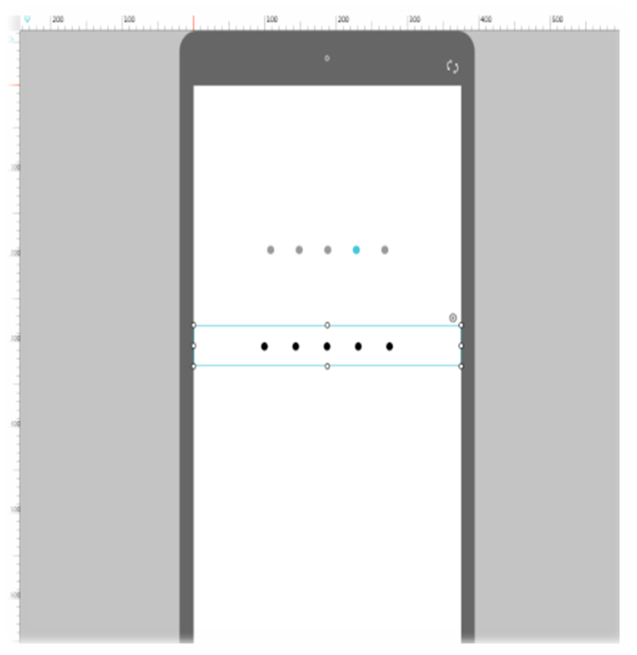
Adjust the shapes and intervals of the dots by changing text size and interval;

Slide 19
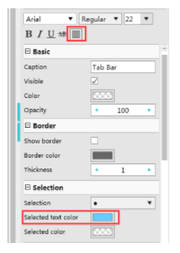
One feature of the Page Control is that selecting a dot will automatically change its color, and the Tab Bar has the similar feature, which is the reason why we choose to use a Tab Bar to make a Page Control.
Set the text color to light gray;
Set the selected text color to lightblue;

Slide 20
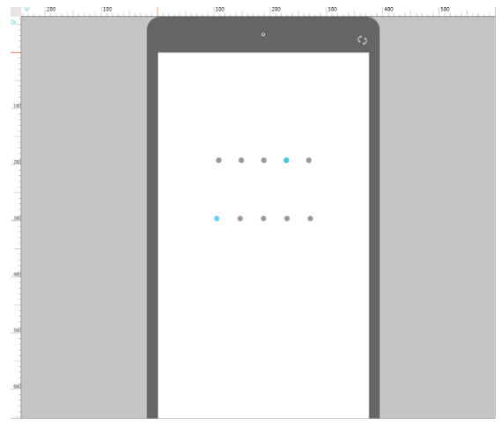
Finally, we get a Page Control by modifying a Tab Bar.

Slide 21
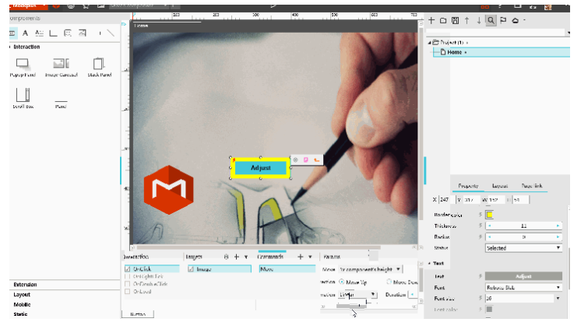

Step 1

Slide 22
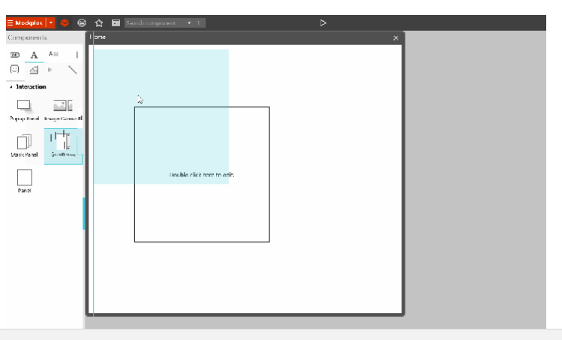
Step 2

Slide 23
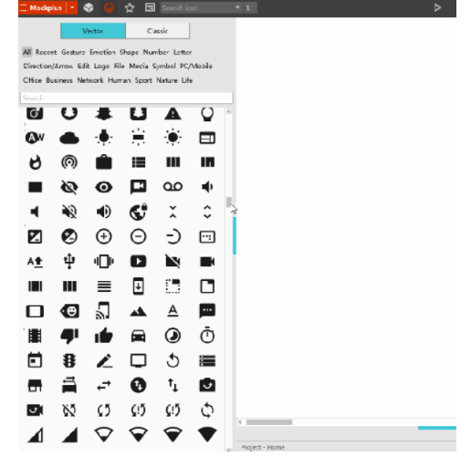
Step 3

Slide 24
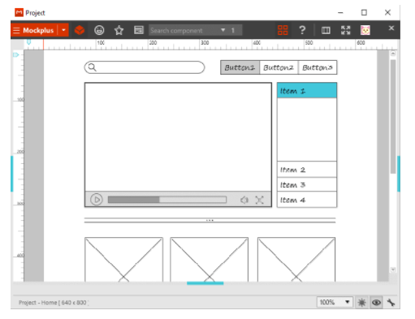
Step 4

Slide 25


